Slide 1
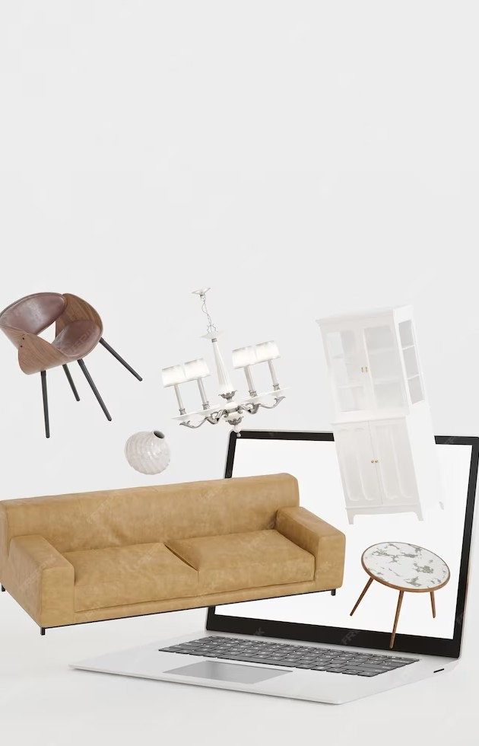
Creating ElegantSpaces Decor: Unleashing Creativity in Home Decor Website Design

Slide 2
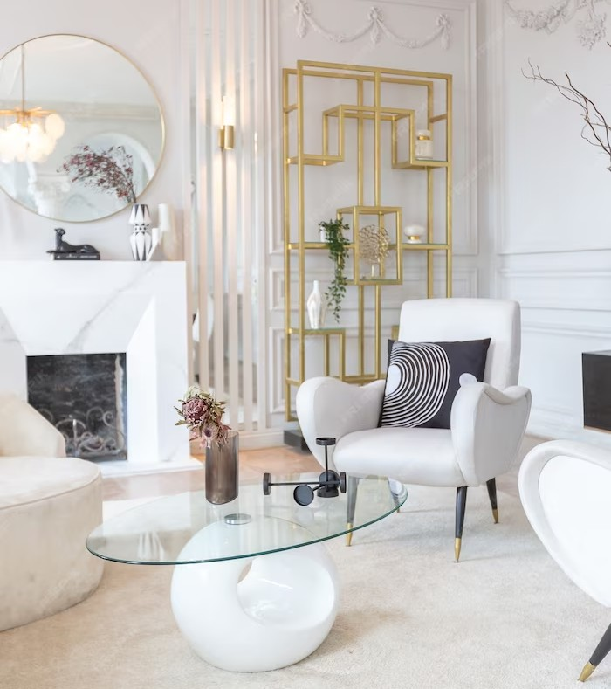
Introduction
Welcome to the world of ElegantSpaces Decor! In this presentation, we will explore the art of creating stunning home decor websites. Get ready to unleash your creativity and transform ordinary spaces into extraordinary masterpieces.
Let's dive in!

Slide 3
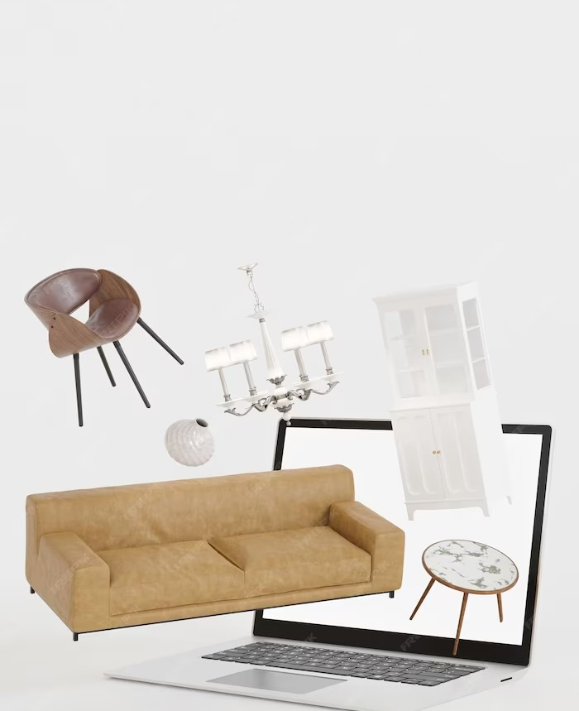
Understanding Home Decor Website Design
Designing a home decor website is all about capturing the essence of elegance and showcasing it through visually appealing layouts and captivating color schemes. It's about creating an online space that inspires and enchants visitors, making them want to explore further.

Slide 4
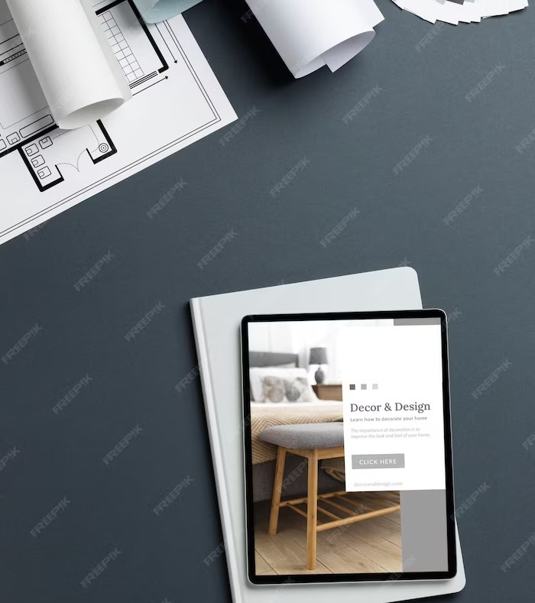
Unleashing Your Creativity
When it comes to home decor website design, creativity knows no bounds. Experiment with unique fonts, use stunning imagery to evoke emotions, and incorporate intuitive navigation to enhance user experience. Remember, the key is to create an online space that reﬂects your brand's personality and leaves a lasting impression.

Slide 5
Conclusion
Designing an elegant home decor website is an exciting journey that requires a blend of creativity, attention to detail, and a deep understanding of your target audience. By following the tips shared in this presentation, you can create a website that not only impresses visitors but also drives conversions. Now, go forth and create stunning online spaces that inspire!

Slide 6
Thanks!
Do you have any questions? elegencespacesdecore@example.com
+91 1234567890
elegencespacesdecore@example.com

